Slide 1


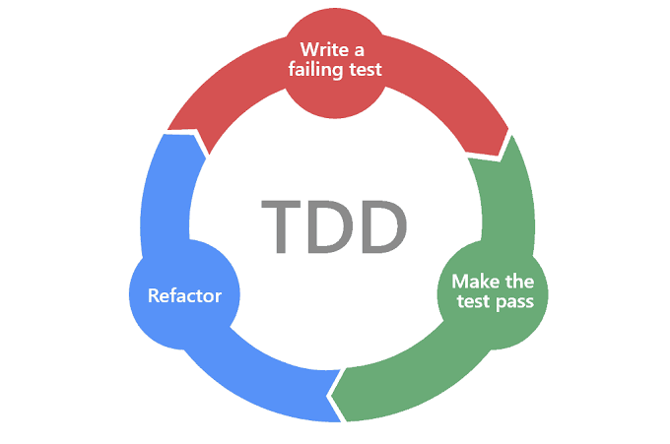
TDD,JUnit,Mockito

Slide 3
Test Driven Development
Test-driven development starts with developing test for each one of the features.
The test might fail as the tests are developed even before the development. Development team then develops and refactors the code to pass the test.
Test-driven development is related to the test-first programming evolved as part of extreme programming concepts.

Slide 4
Test Driven Development (TDD) is software development approach in which test cases are developed to specify and validate what the code will do.
In simple terms, test cases for each functionality are created and tested first and if the test fails then the new code is written in order to pass the test and making code simple and bug-free.
Test-Driven Development starts with designing and developing tests for every small functionality of an application.
TDD instructs developers to write new code only if an automated test has failed. This avoids duplication of code. The full form of TDD is Test-driven development.

Slide 5
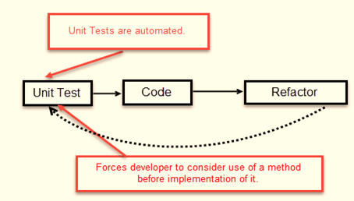

Slide 6
How to perform TDD Test
Following steps define how to perform TDD test,
Add a test.
Run all tests and see if any new test fails.
Write some code.
Run tests and Refactor code.
Repeat.

Slide 7
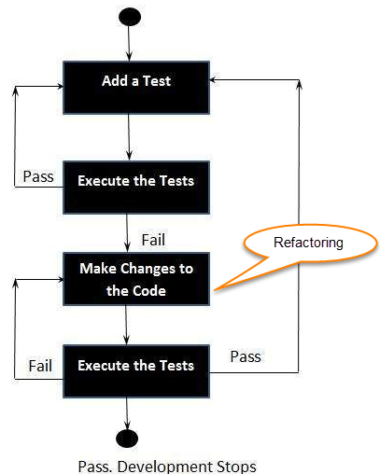

Slide 8
Test-Driven Development Process
Add a Test
Run all tests and see if the new one fails
Write some code
Run tests and Refactor code
Repeat

Slide 9
Context of Testing
Valid inputs
Invalid inputs
Errors, exceptions, and events
Boundary conditions
Everything that might break

Slide 10
What is acceptance TDD and Developer TDD
Acceptance TDD (ATDD):
With ATDD you write a single acceptance test.
This test fulfills the requirement of the specification or satisfies the behavior of the system.
After that write just enough production/functionality code to fulfill that acceptance test.
Acceptance test focuses on the overall behavior of the system.
ATDD also was known as Behavioral Driven Development (BDD).

Slide 11
Developer TDD:
With Developer TDD you write single developer test i.e. unit test and then just enough production code to fulfill that test.
The unit test focuses on every small functionality of the system. Developer TDD is simply called as TDD.

Slide 12
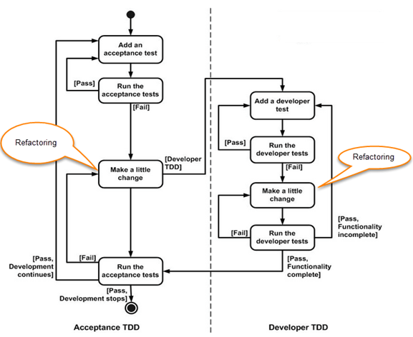

Slide 13
Benefits of TDD
Much less debug time
Code proven to meet requirements
Tests become Safety Net
Near zero defects
Shorter development cycles

Slide 14
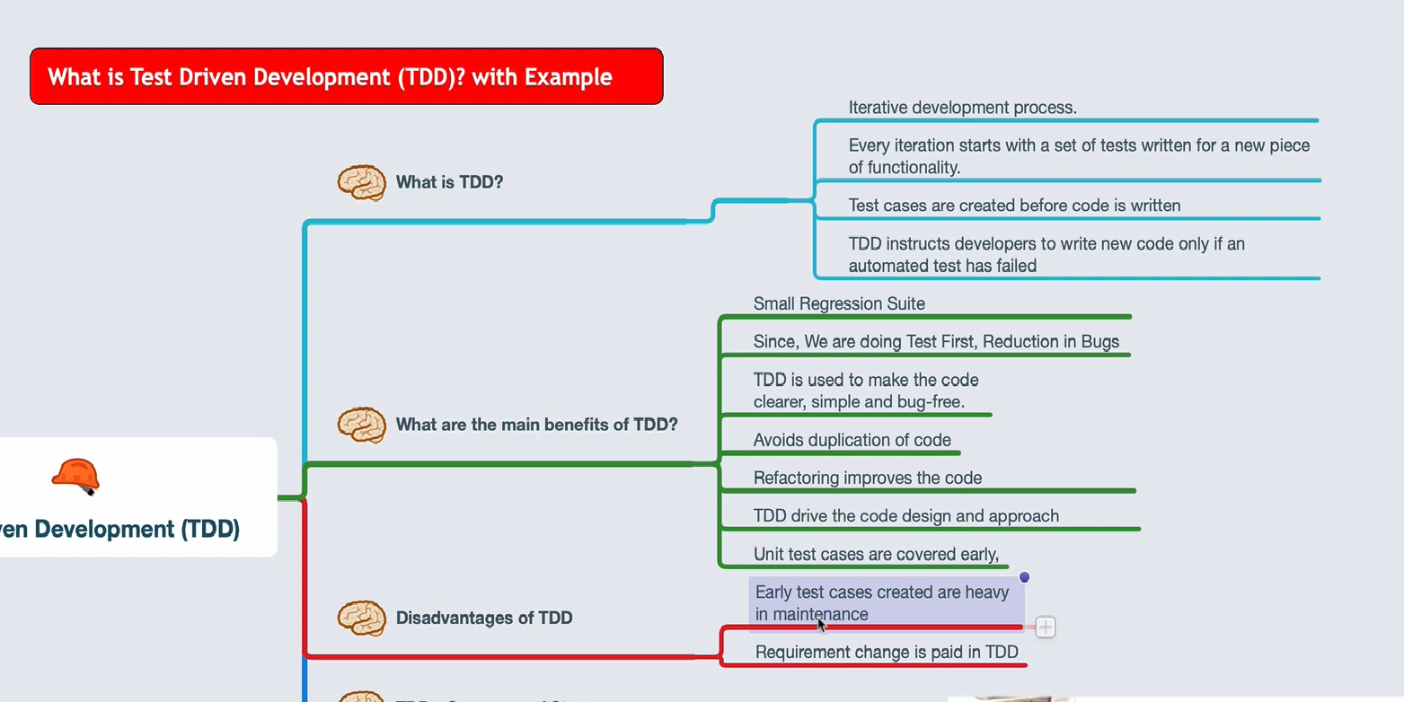

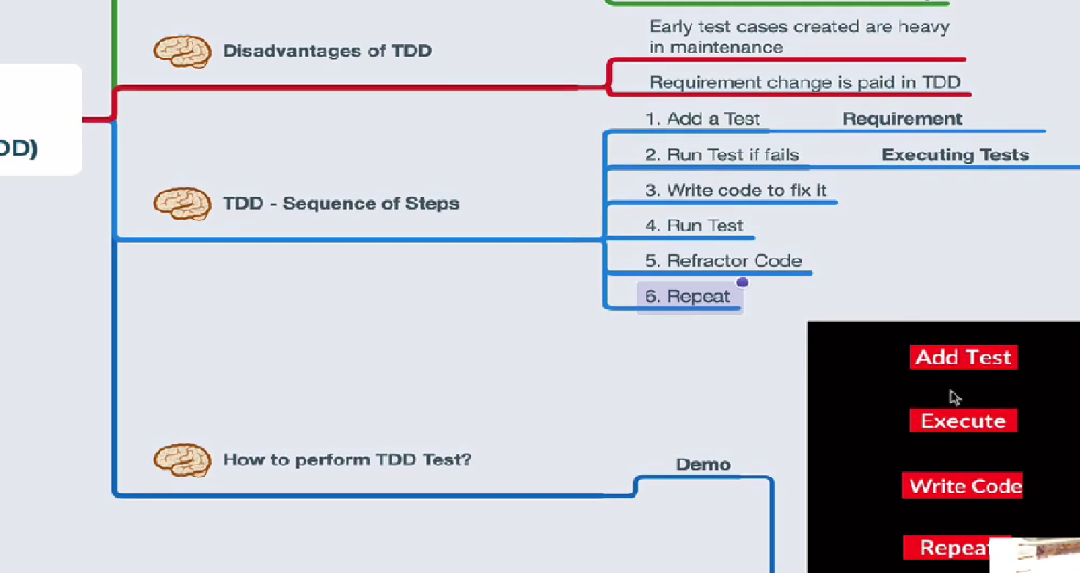

Slide 17
What is Junit?
JUnit is a unit testing framework for Java programming language.
It plays a crucial role test-driven development, and is a family of unit testing frameworks collectively known as xUnit.
JUnit promotes the idea of "first testing then coding", which emphasizes on setting up the test data for a piece of code that can be tested first and then implemented.
This approach is like "test a little, code a little, test a little, code a little."
It increases the productivity of the programmer and the stability of program code, which in turn reduces the stress on the programmer and the time spent on debugging.

Slide 18
Features of JUnit
JUnit is an open source framework, which is used for writing and running tests.
Provides annotations to identify test methods.
Provides assertions for testing expected results.
Provides test runners for running tests.
JUnit tests allow you to write codes faster, which increases quality.
JUnit is elegantly simple. It is less complex and takes less time.

Slide 19
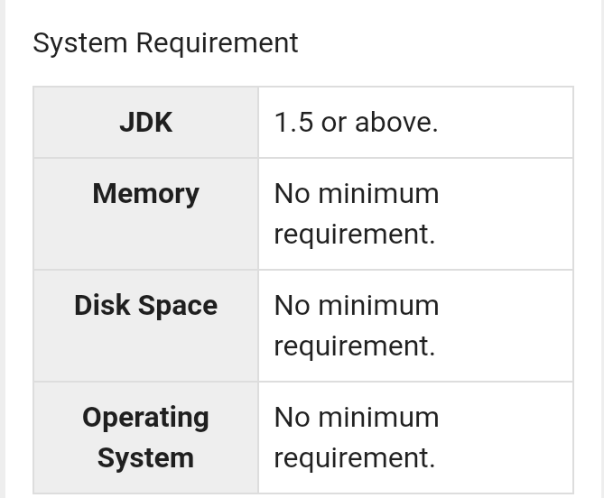
JUnit - Environment Setup

Slide 20
Step 1: Verify Java Installation in Your Machine
Step 2: Set JAVA Environment
Step 3: Download JUnit Archive
Step 4: Set JUnit Environment
Step 5: Set CLASSPATH Variable
Step 6: Test JUnit Setup

Slide 21
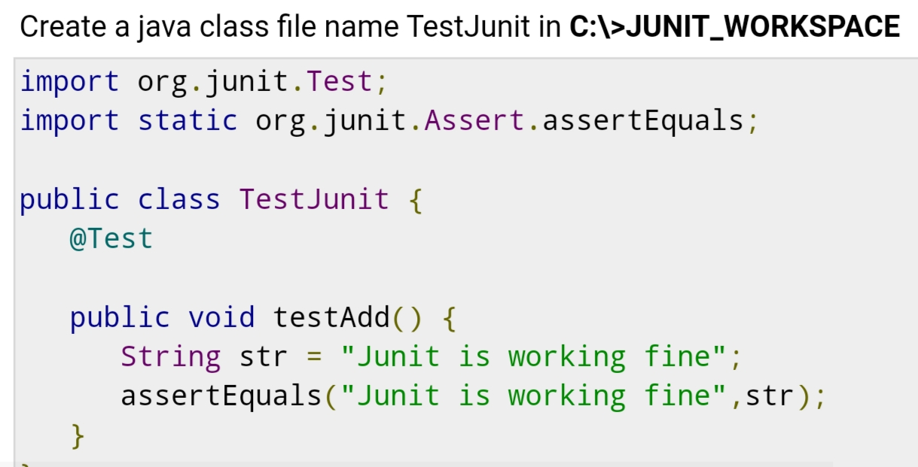

Slide 22
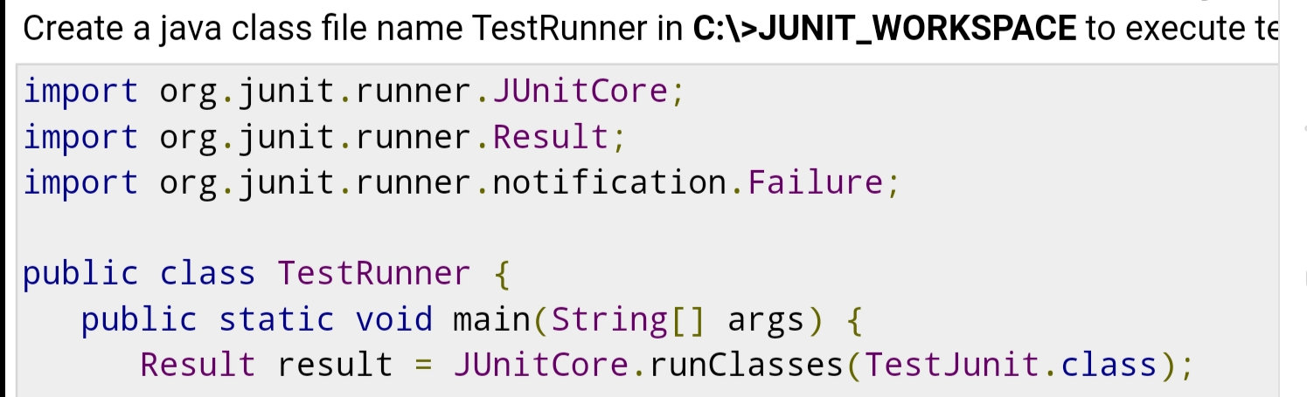
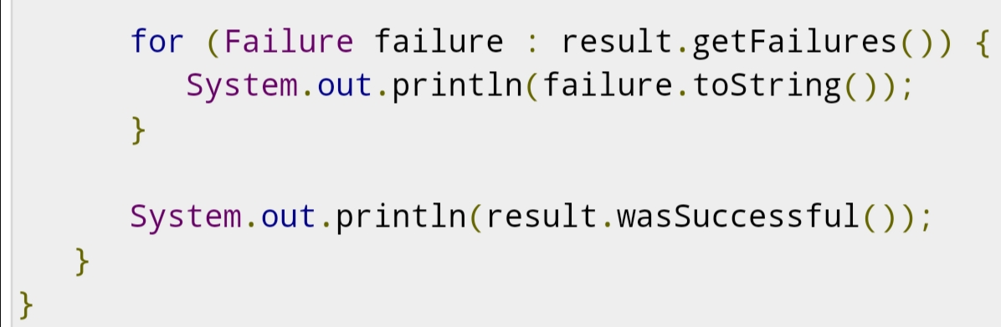

Slide 23
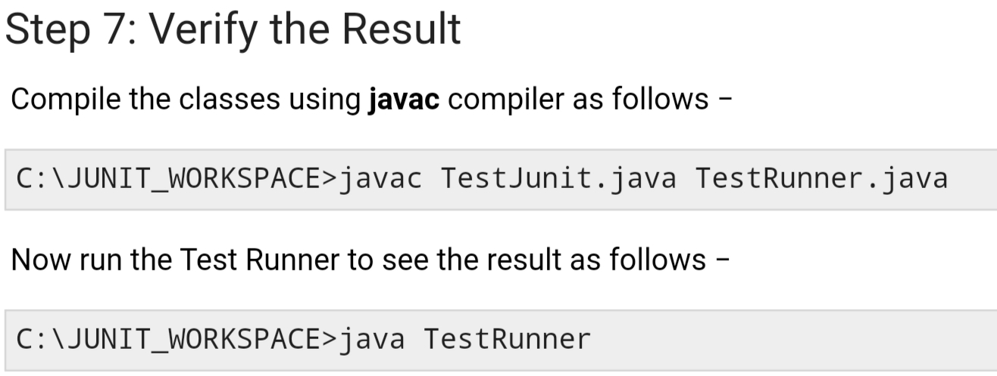
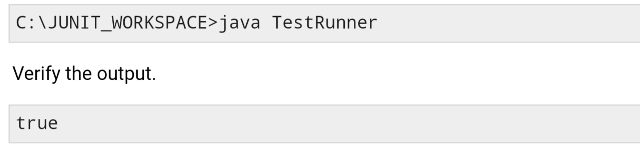

Slide 24
JUnit - Test Framework
JUnit is a Regression Testing Framework used by developers to implement unit testing in Java, and accelerate programming speed and increase the quality of code.
JUnit Framework can be easily integrated with either of the following −
Eclipse
Ant
Maven

Slide 25
Features of JUnit Test Framework
JUnit test framework provides the following important features −
Fixtures
Test suites
Test runners
JUnit classes

Slide 26
JUnit Classes
JUnit classes are important classes, used in writing and testing JUnits. Some of the important classes are −
Assert − Contains a set of assert methods.
TestCase − Contains a test case that defines the fixture to run multiple tests.
TestResult − Contains methods to collect the results of executing a test case.

Slide 27
JUnit - API

Slide 28
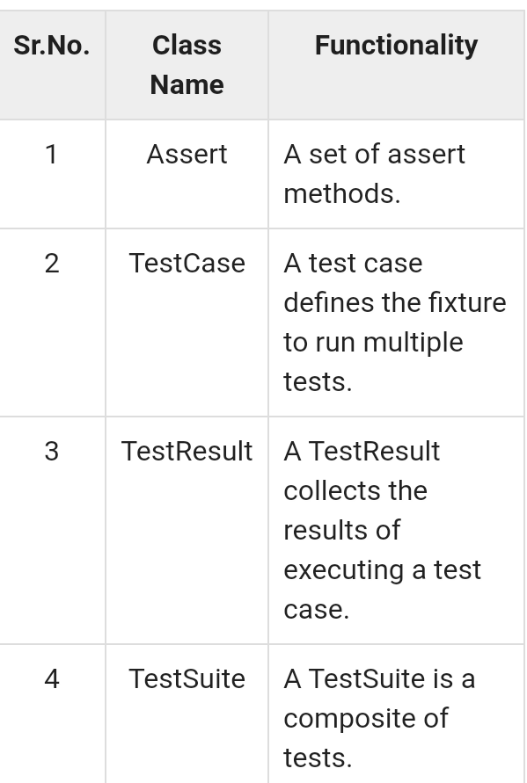

Slide 29
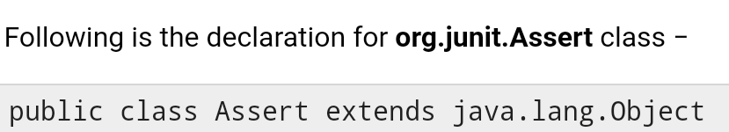
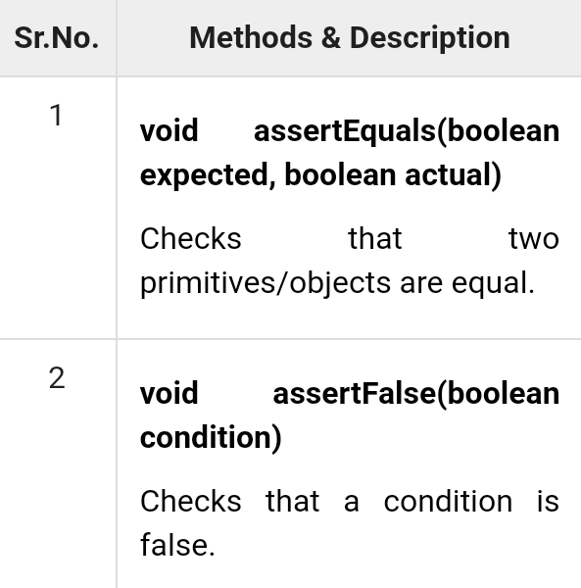
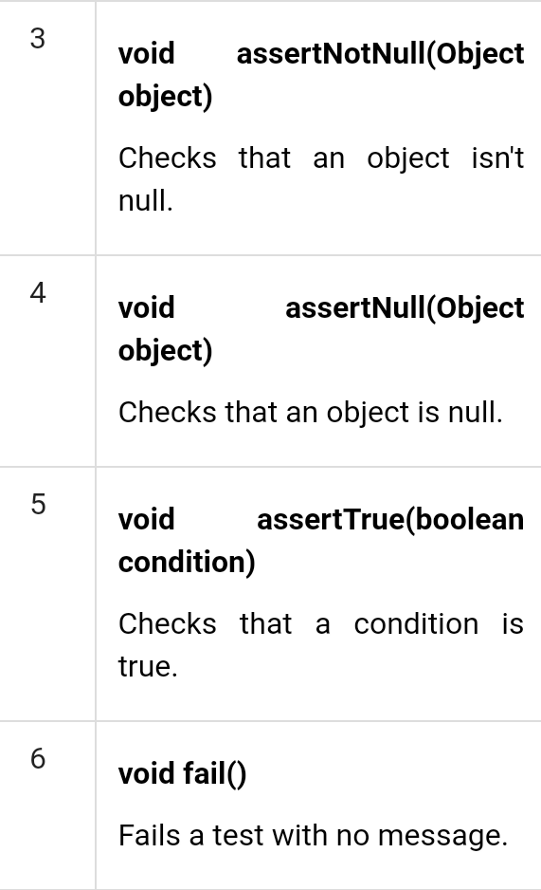
Assert Class

Slide 30
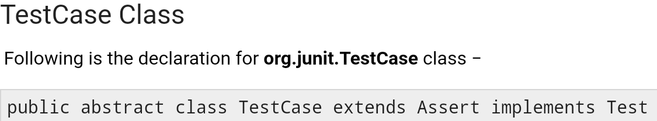
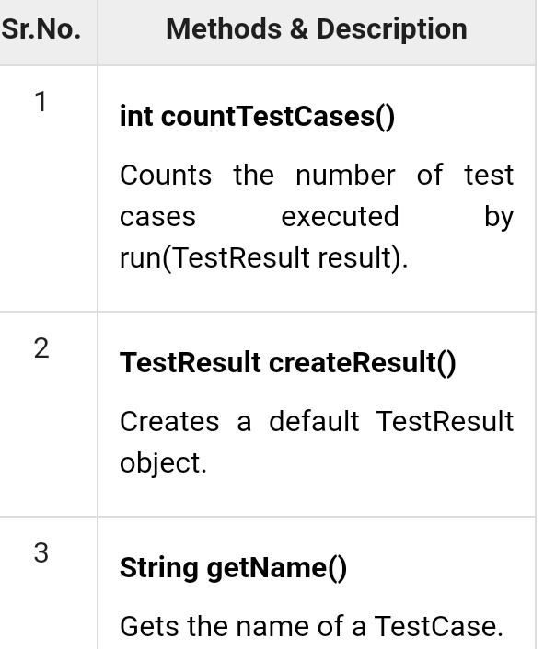
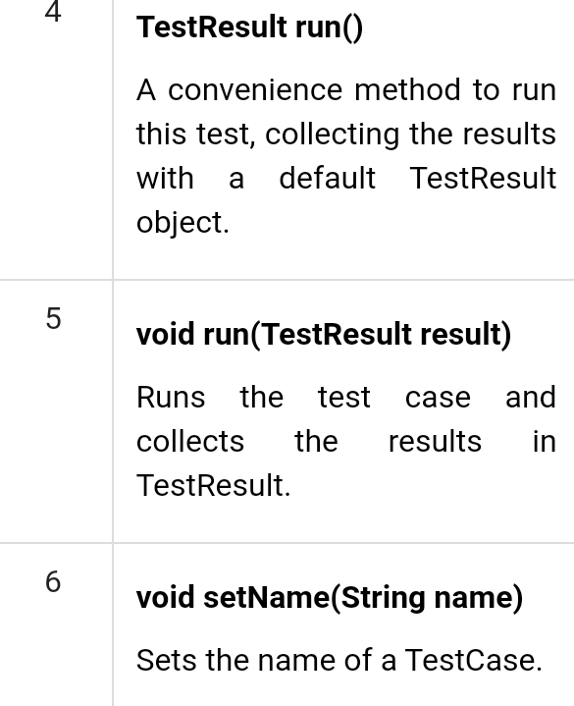

Slide 31
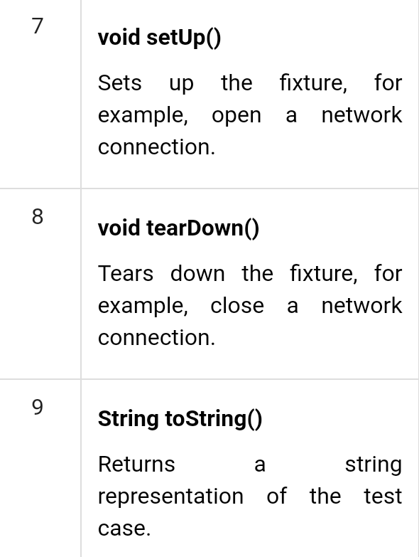

Slide 32
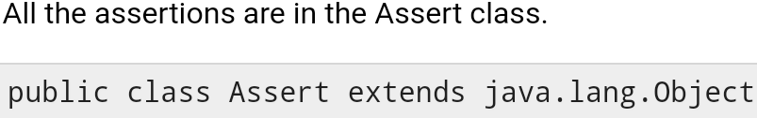
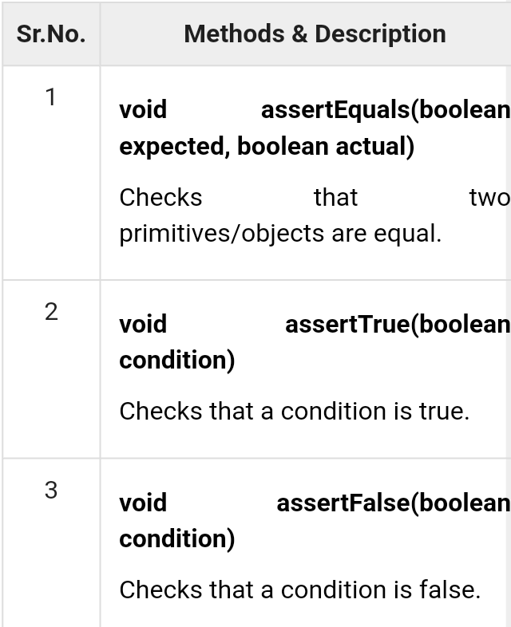
JUnit - Using Assertion

Slide 33
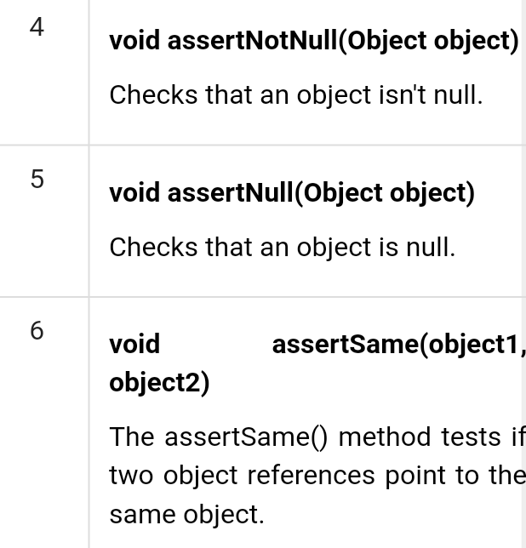
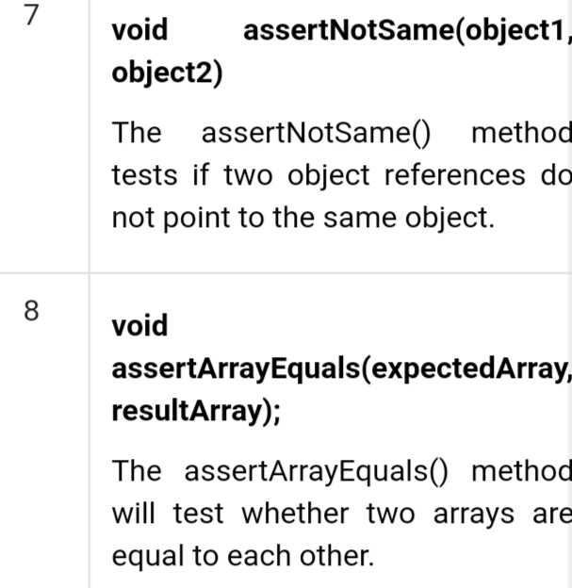

Slide 34
Annotation
Annotations are like meta-tags that you can add to your code, and apply them to methods or in class. These annotations in JUnit provide the following information about test methods −
which methods are going to run before and after test methods.
which methods run before and after all the methods, and.
which methods or classes will be ignored during the execution.

Slide 35
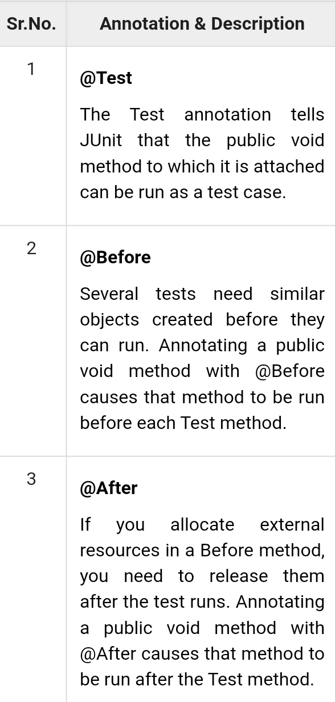
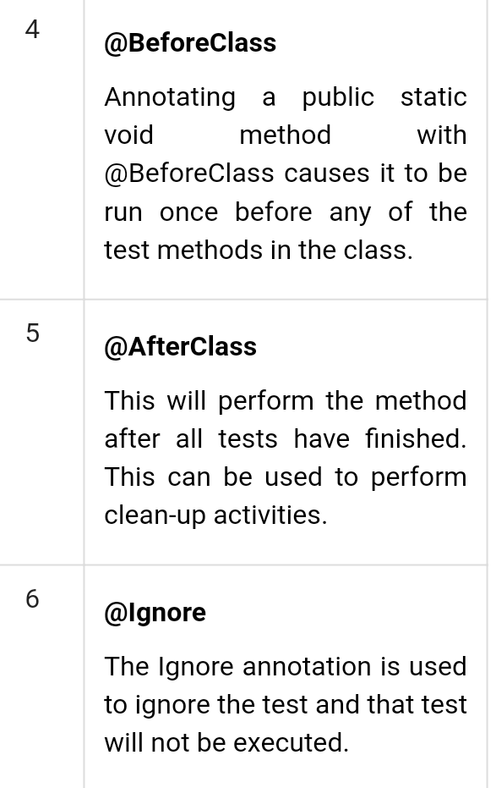

Slide 36
JUnit - Execution Procedure
Create a java class file named ExecutionProcedureJunit.java in C:\>JUNIT_WORKSPACE to test annotation.
Next, create a java class file named TestRunner.java in C:\>JUNIT_WORKSPACE to execute annotations.

Slide 37
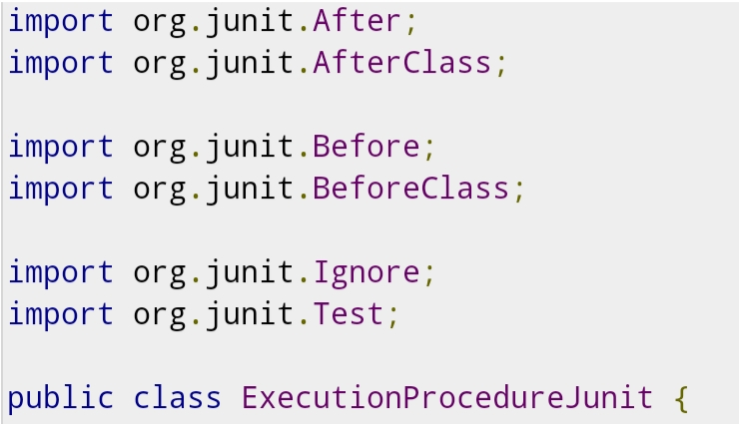
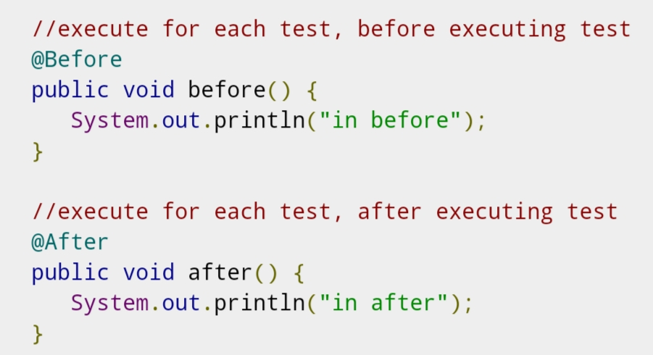
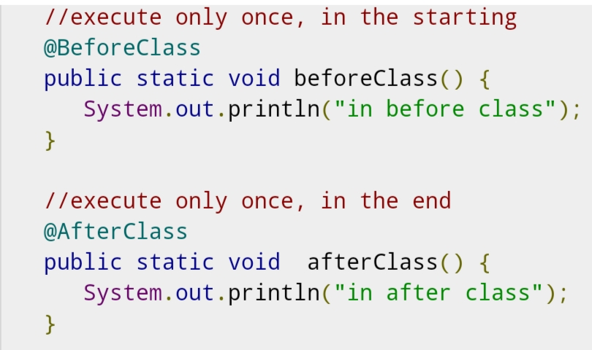
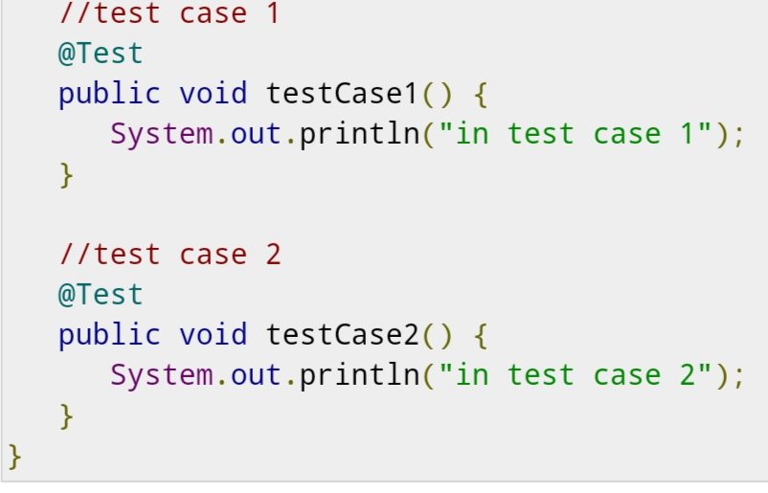

Slide 38
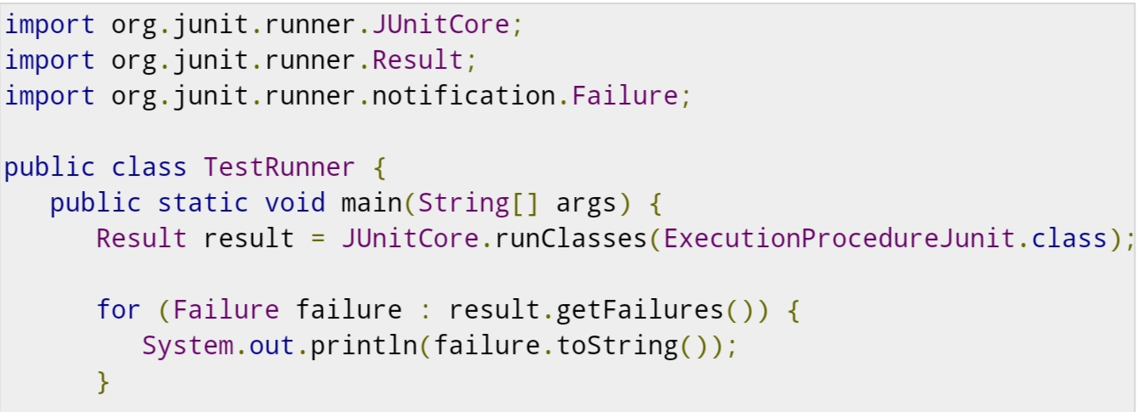
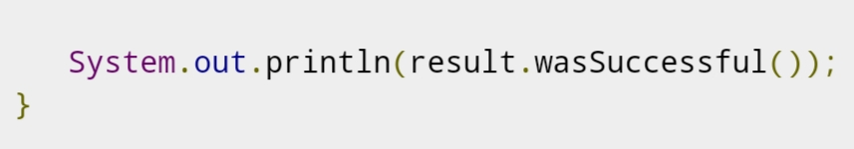

Slide 39
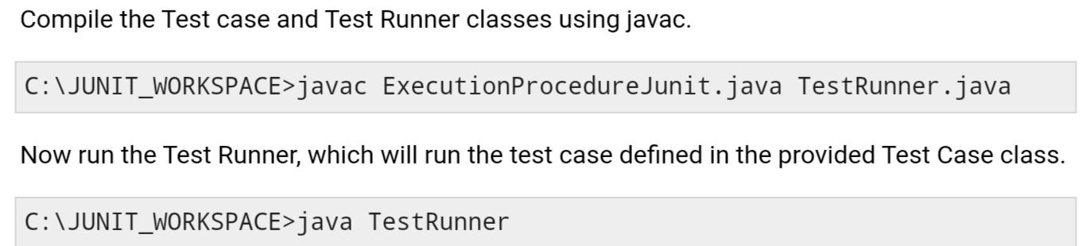
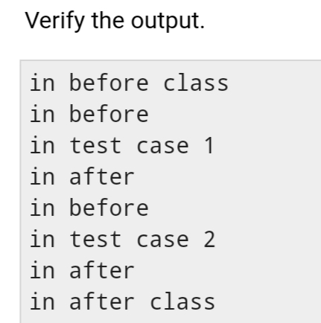

Slide 40
Basic Test in Junit
JUnit - Suite Test
JUnit - Ignore Test
JUnit - Time Test
JUnit - Exceptions Test
JUnit - Parameterized Test

Slide 42
What is Mocking?
Mocking is a way to test the functionality of a class in isolation.
Mocking does not require a database connection or properties file read or file server read to test a functionality.
Mock objects do the mocking of the real service. A mock object returns a dummy data corresponding to some dummy input passed to it.

Slide 43
Benefits of Mockito
No Handwriting − No need to write mock objects on your own.
Refactoring Safe − Renaming interface method names or reordering parameters will not break the test code as Mocks are created at runtime.
Return value support − Supports return values.
Exception support − Supports exceptions.
Order check support − Supports check on order of method calls.
Annotation support − Supports creating mocks using annotation.

Slide 44
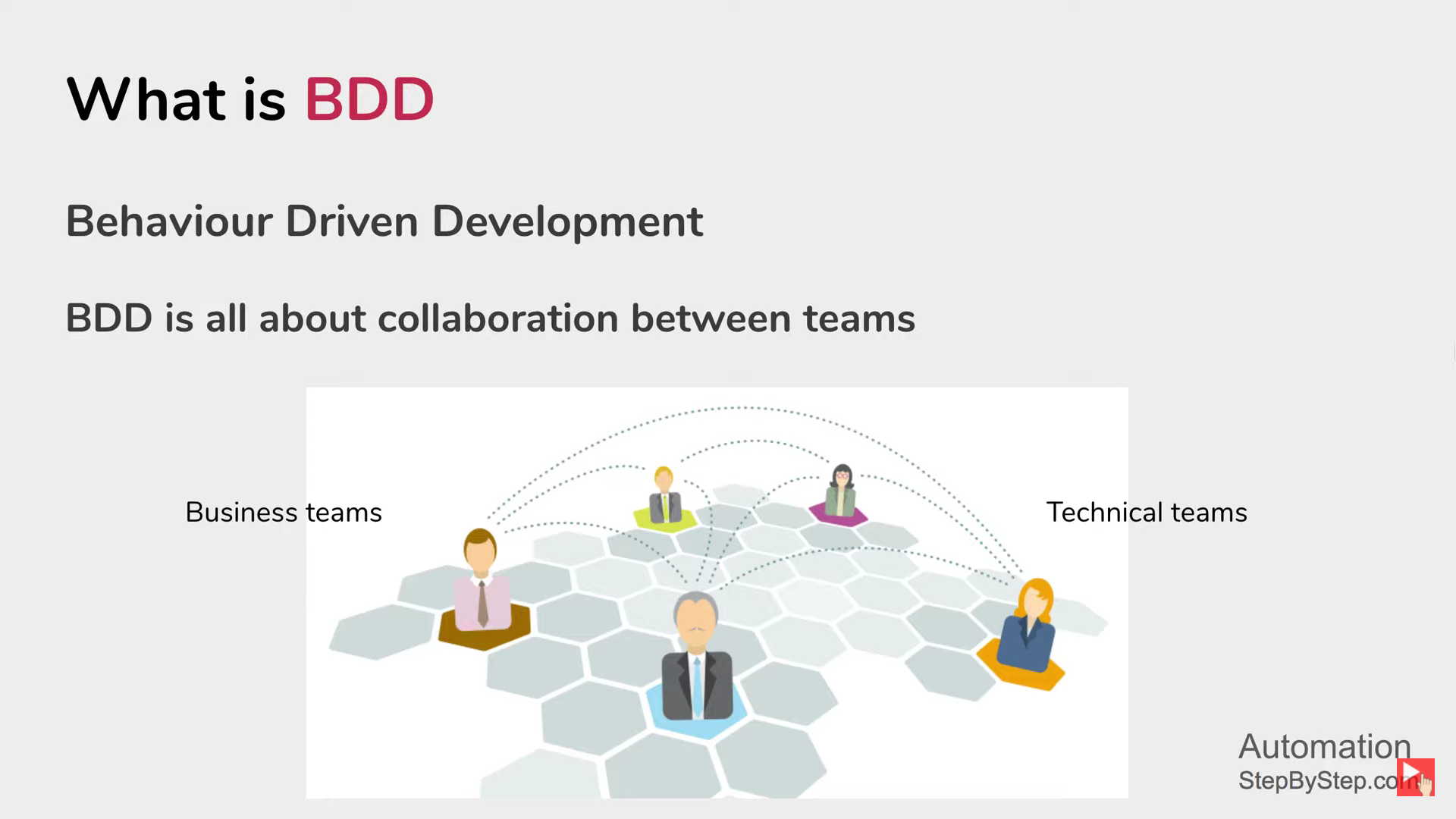

Slide 45
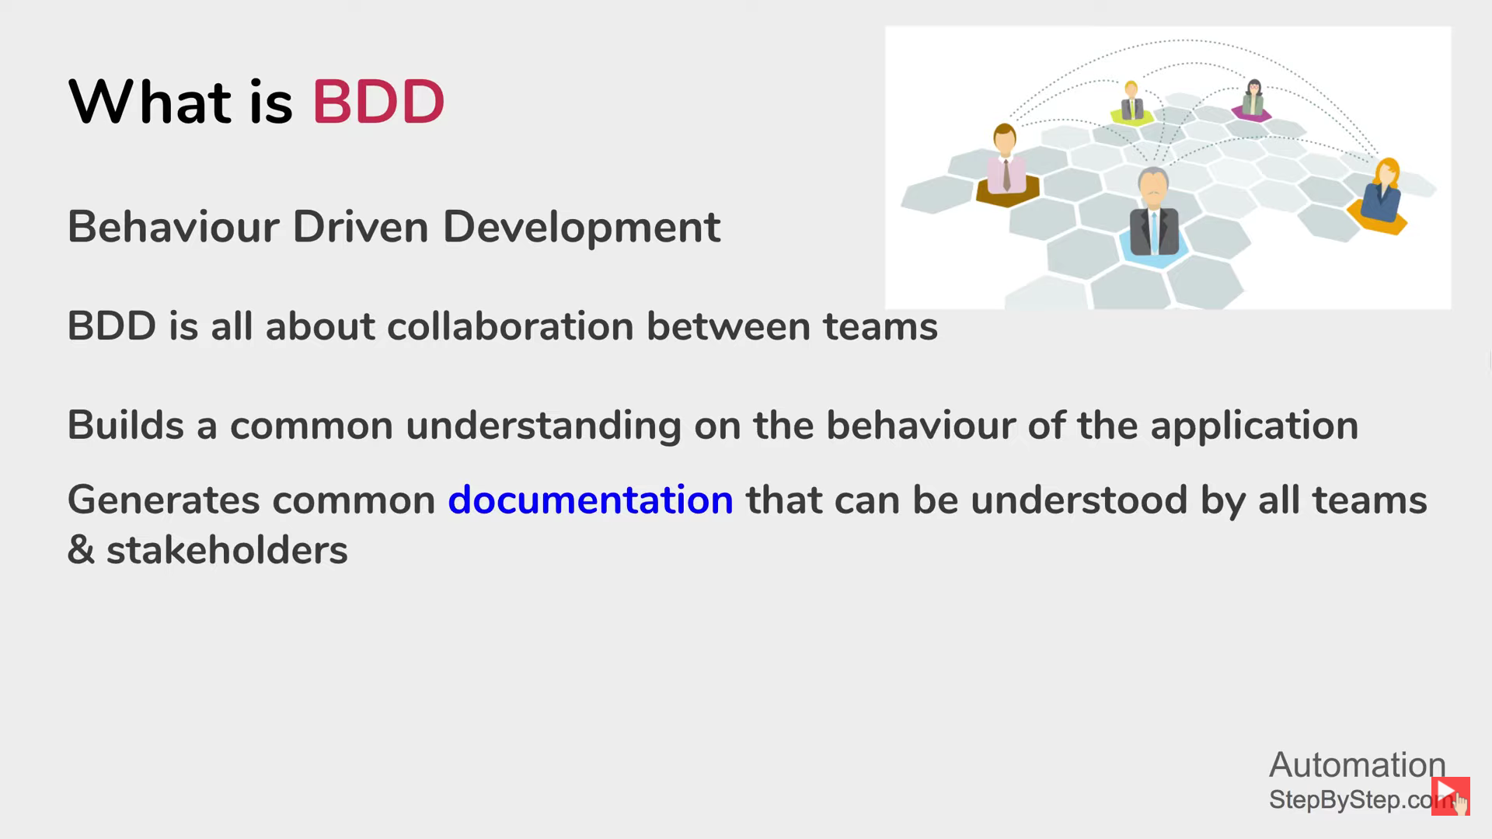

Slide 46
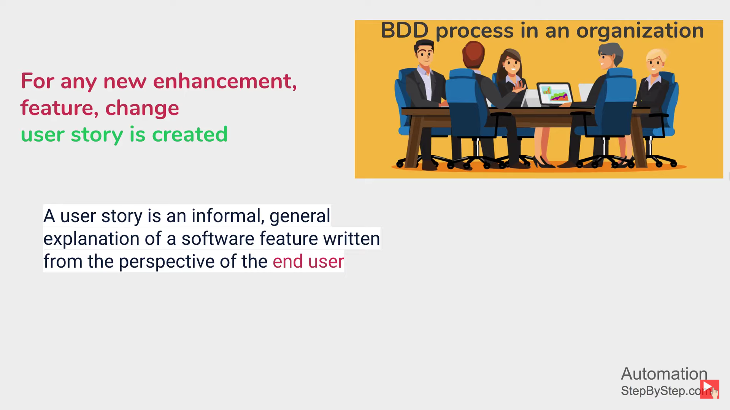

Slide 47
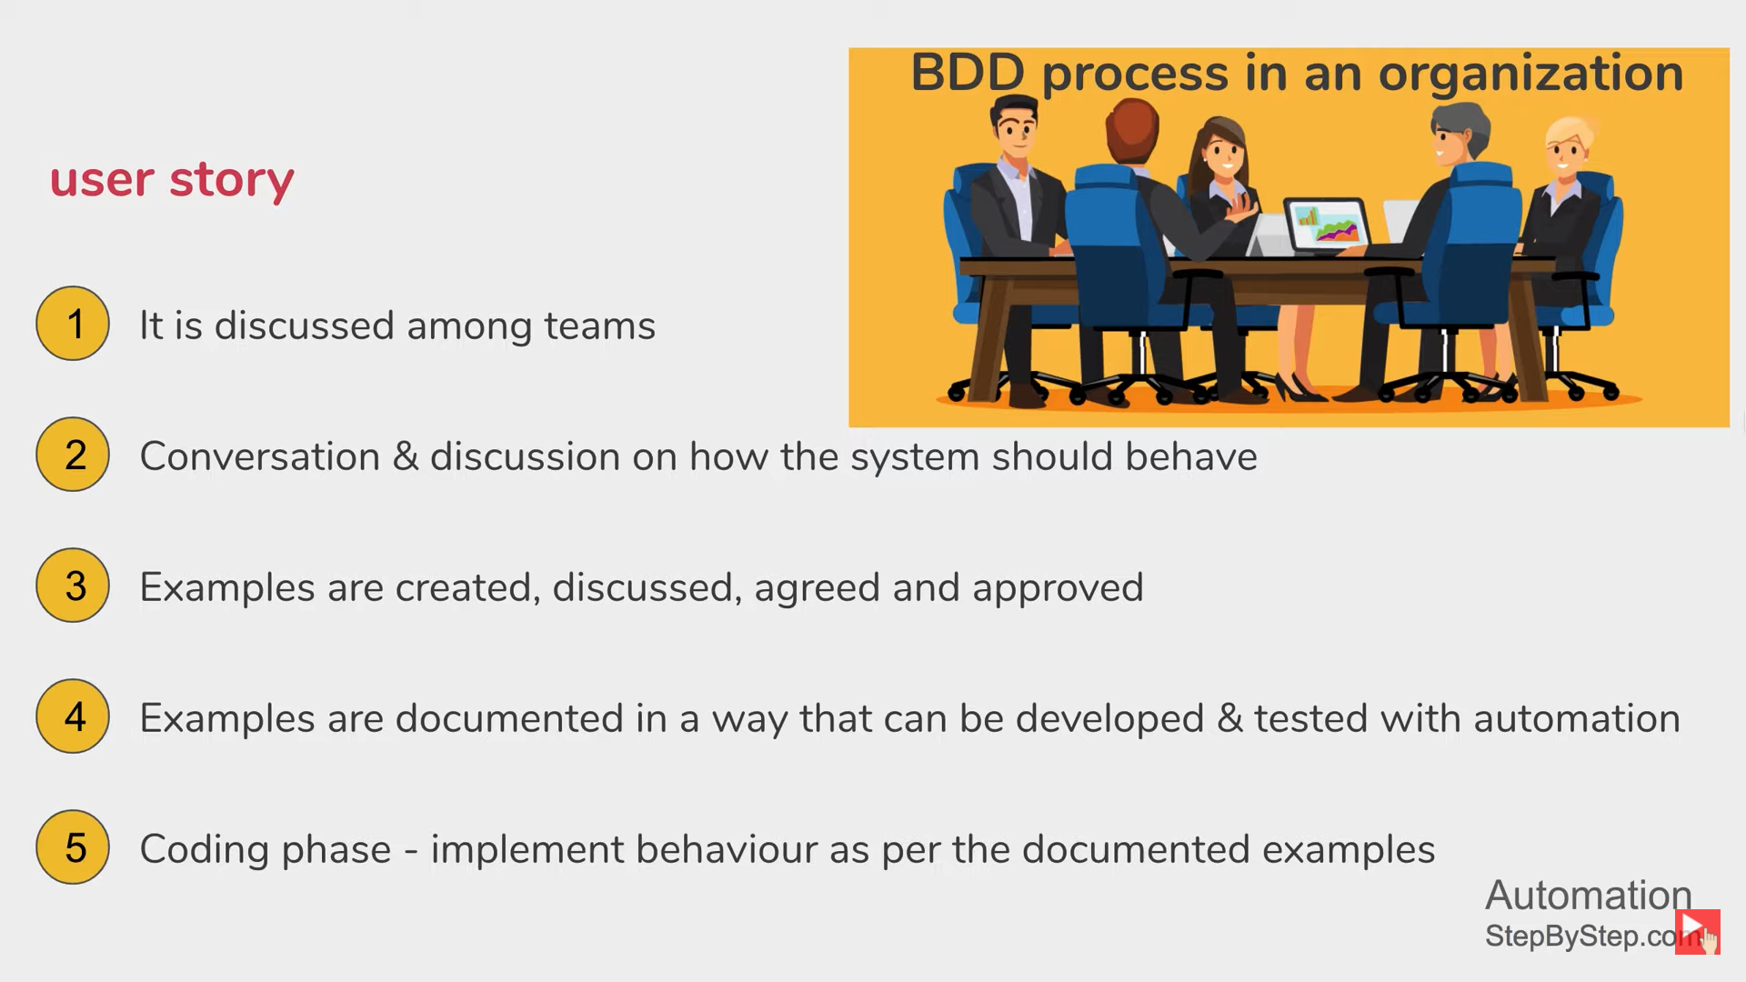

Slide 48
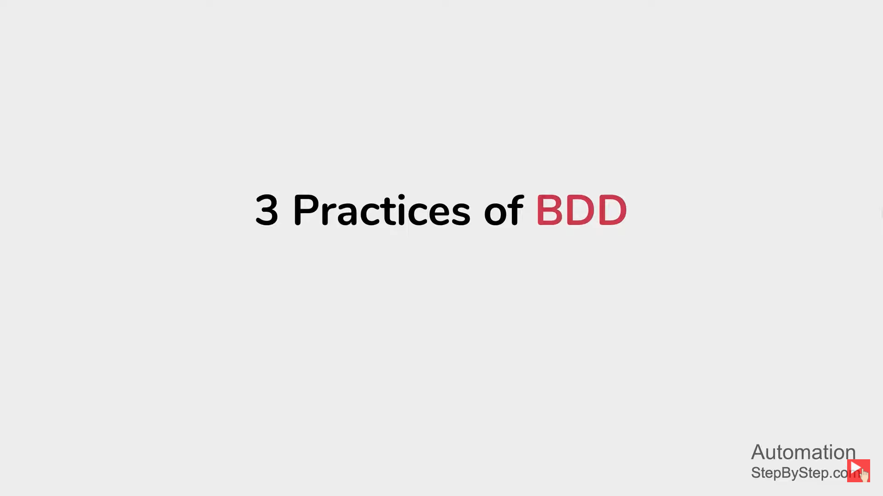

Slide 49
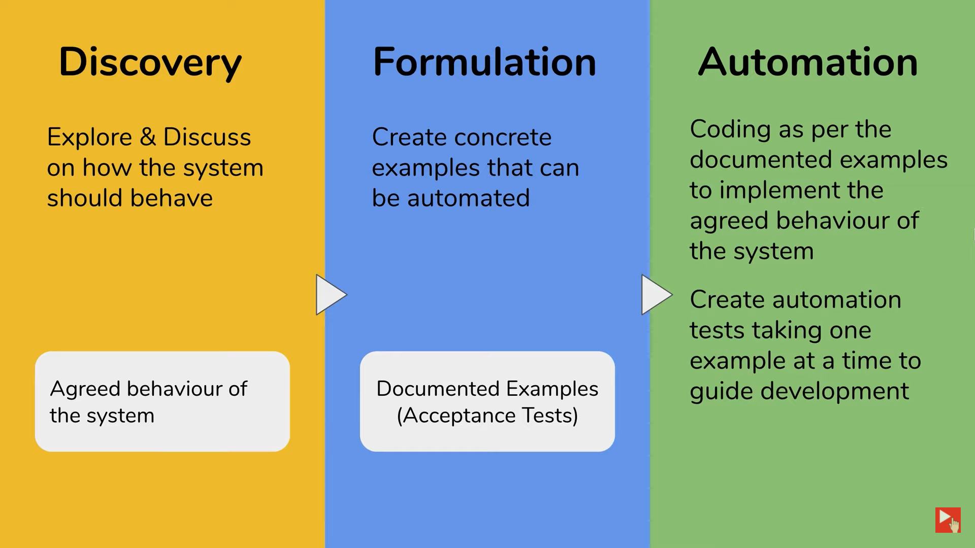
Code Implementation & Automation Test

Slide 50
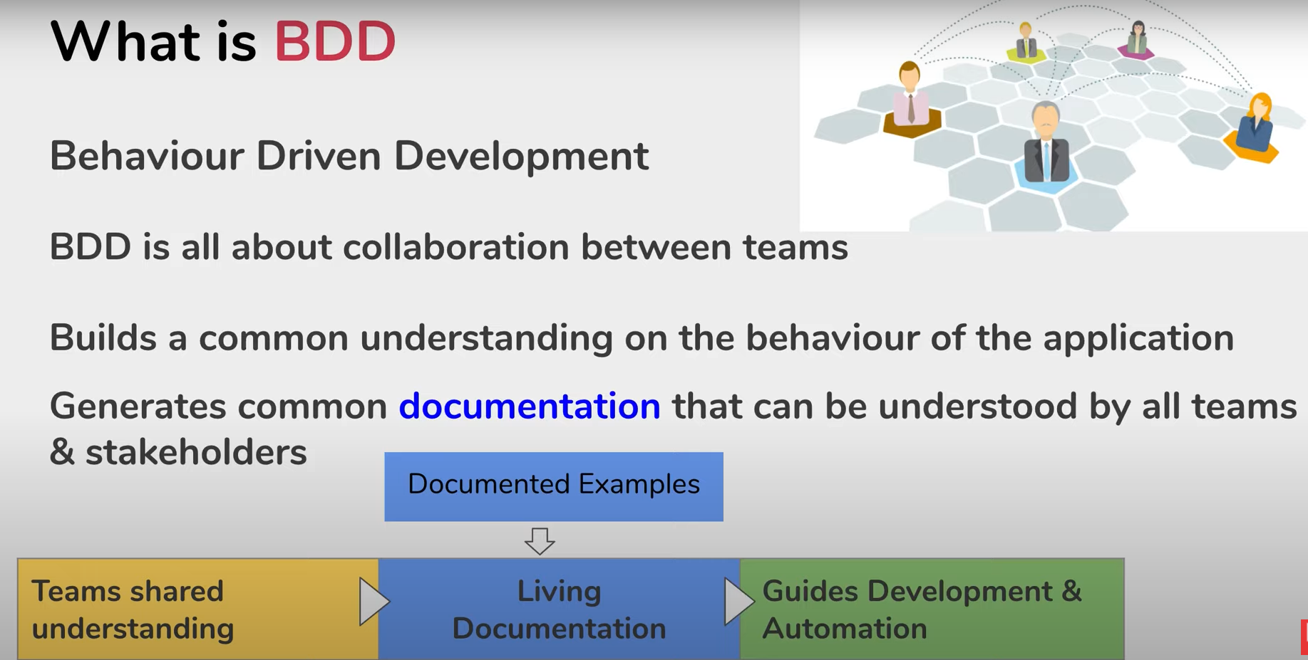

Slide 51
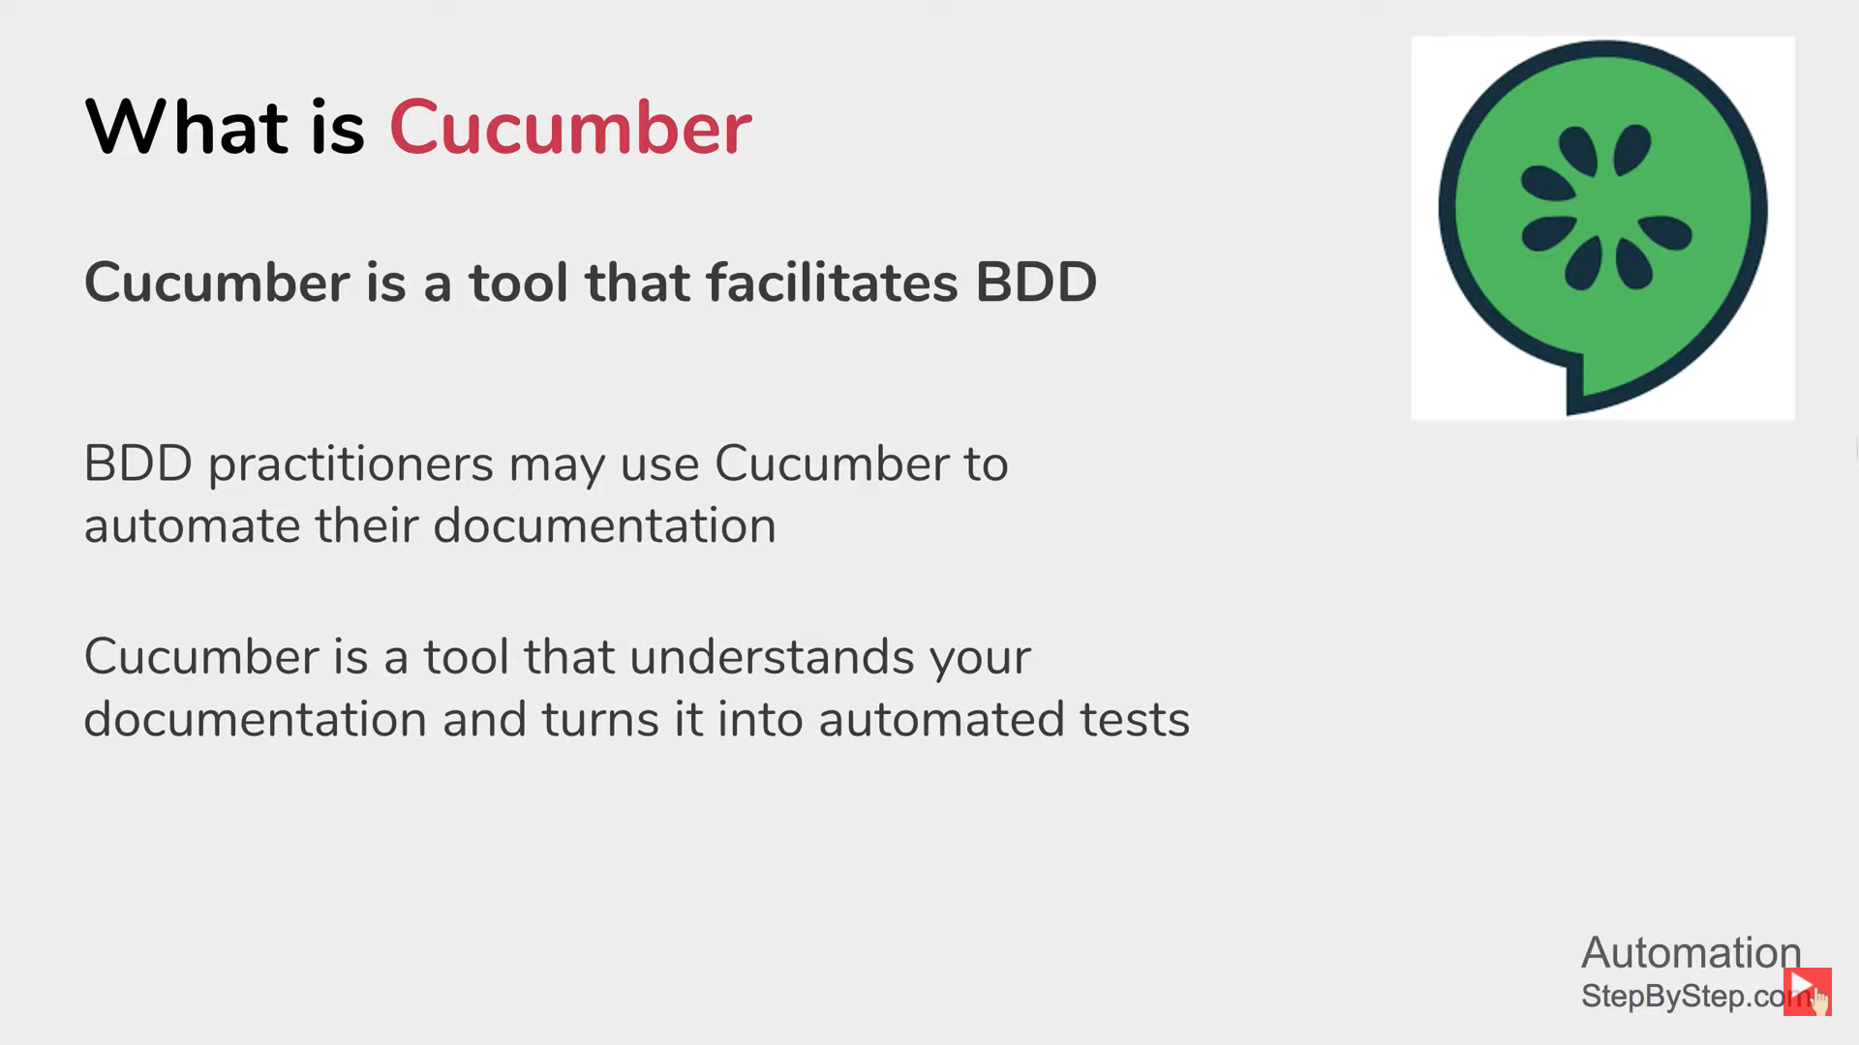

Slide 52
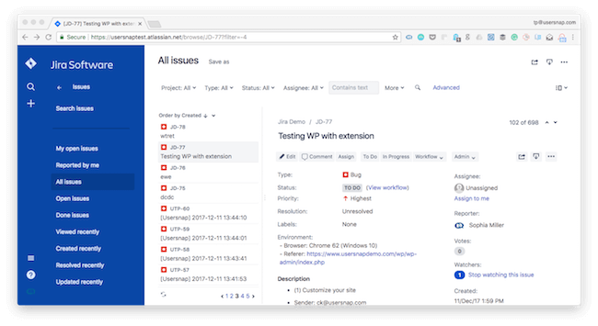

Slide 53
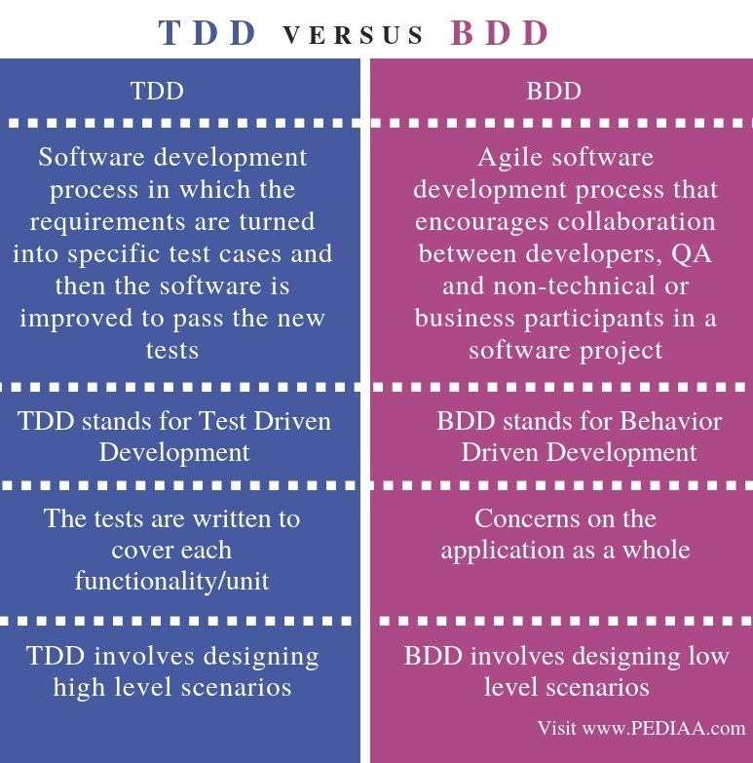

Slide 54
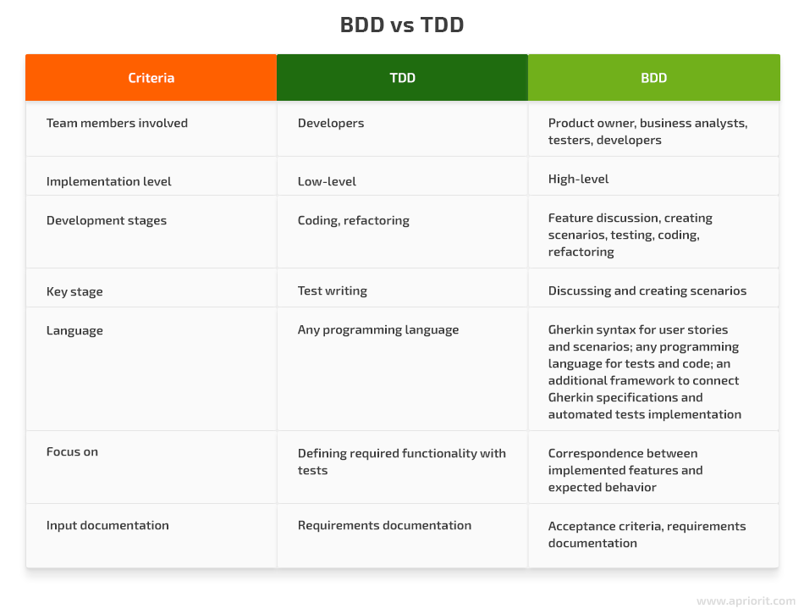

Slide 55
